Slide 1



Warsaw University Of Technology
Faculty of Mathematics and Information Science

Slide 2
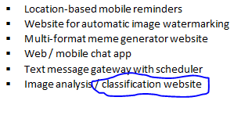
The idea that I implemented
Why:
Because it’s simple
Easy to understand
Easy to implement
Easy to Deploy on AWS

Slide 3
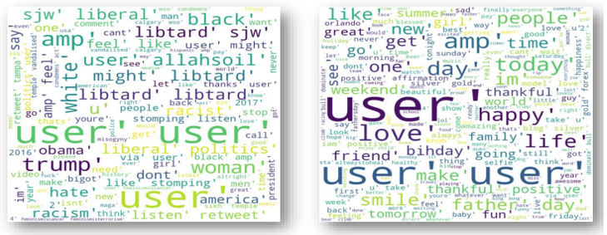
Data Information
Twitter Hate Speech Data: Dataset using Twitter data, is was used to research hate-speech detection. The text is classified as: hate-speech, offensive language, and neither. Due to the nature of the study, it’s important to note that this dataset contains text that can be considered racist, sexist, homophobic, or generally offensive. [1]
Figure 1: Negative Speech Figure 2: Positive Speech

Slide 4
Project Description
A simple web-based detection system built on AWS cloud, which detects the hate and free speech of given input text. This is based on a classification machine learning model created using Amazon Sagemaker. The definition and provision of the resources on the AWS cloud are done through the AWS CloudFormation template.

Slide 5
Functional Requirements
Input as a text of the speech which contains information about hate/free words.
Pass data to TF-IDF vectorizer for feature extractions.
Machine learning model classifies the feature extraction data.
Predict the data whether it’s Hate speech or Free Speech.
User interface web application shows the output result.

Slide 6
Non-Functional Requirements
Ensure high availability of twitter hate/free speech data.
User should get the result as fast as possible.
It should be easy to use. i.e. user just required to type and click then the result is displayed.
Easily to distinguish the hate and free speech based on model accuracy.
The system is scalable and cost efficient.

Slide 7
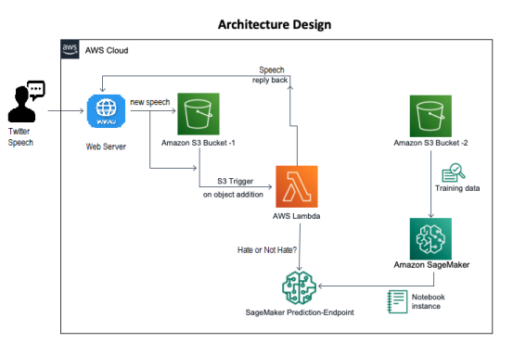
System Architecture
Figure 2: System Architecture

Slide 8

Application Interface
Figure 4: Application Interface

Slide 9
Reference
Hate Speech and Offensive Language Dataset | Kaggle

Slide 10
Thank You☺

